Slide 1
Fusion of Science and Language through Smithsonian Science for the Classroom
Name of Event
Name(s) of Presenter
Notes:
Sarah and Hoover introduce themselves

Slide 2
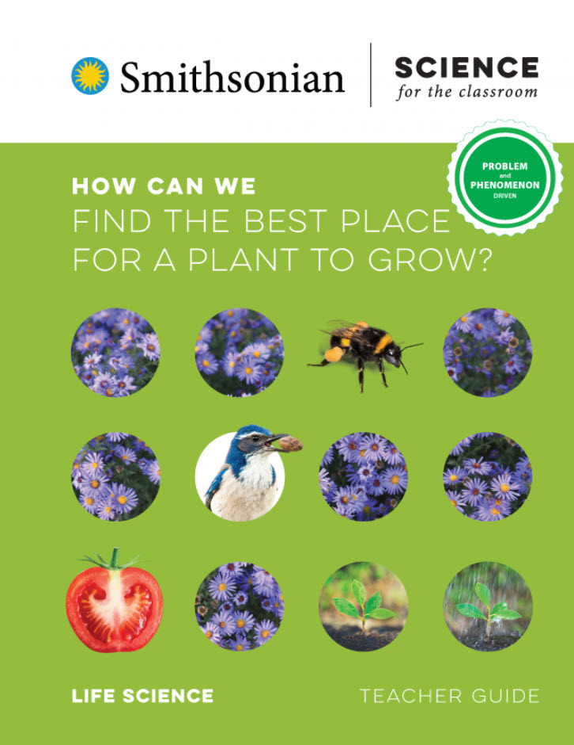
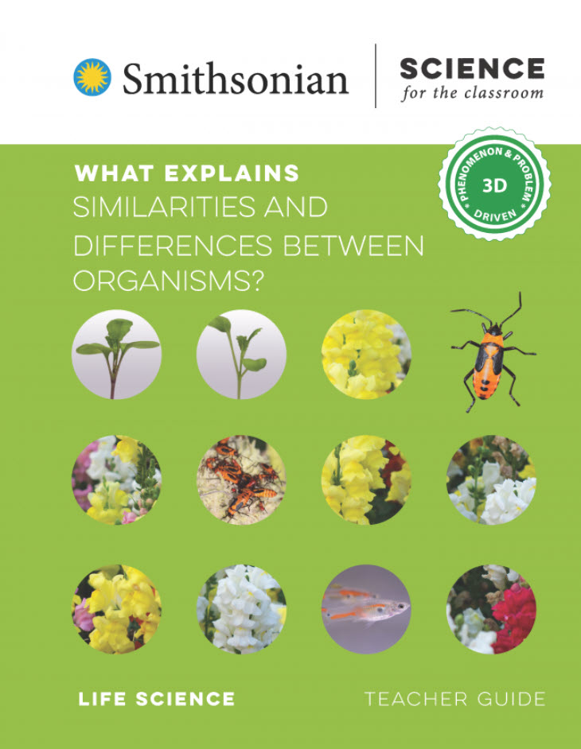
2nd Grade
3rd Grade
Notes:
Today we're going to talk about using science time to build literacy skills using examples from a 2nd and 3rd grade unit from Smithsonian Science for the Classroom. Smithsonian Science for the Classroom is an NGSS-aligned K-5 core science program. There are four modules in each grade. How Can We Find the Best Place for a Plant to Grow? Is the 2nd grade life science module and What Explains Similarities and Differences Between Organisms? is the 3rd grade life science module.

Slide 3
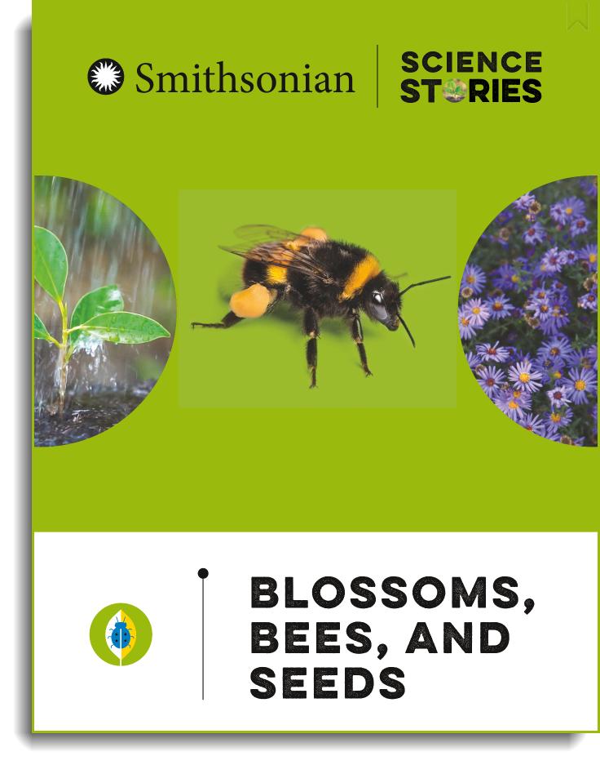
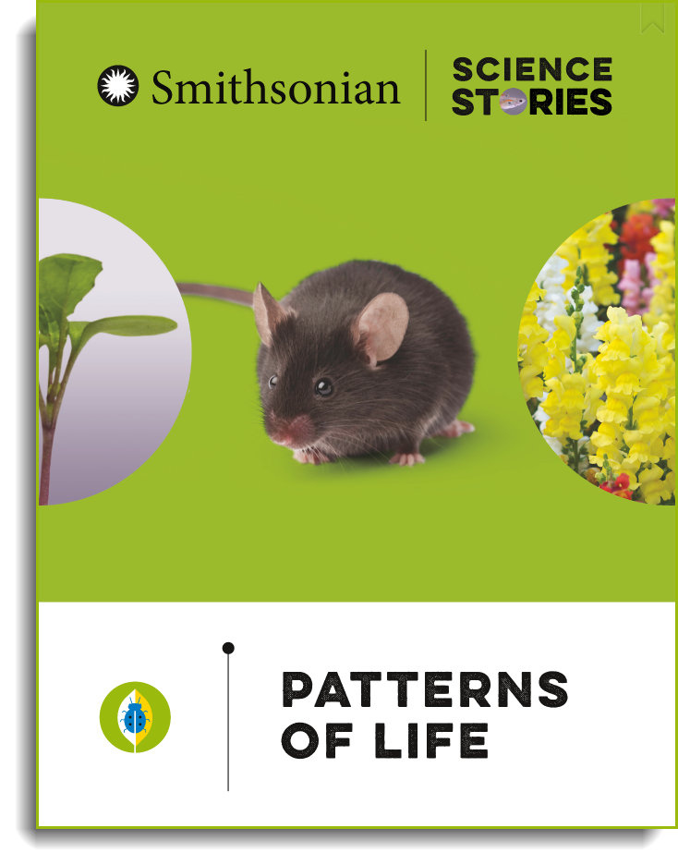
Reading, writing, and speaking for purpose
Notes:
Science time is a great time to build literacy skills because science provides students the motivation to figure out a confusing natural scenario or solve a problem. Students aren't just reading and writing because it's an assignment. Their reading and writing to explore, discover, and make sense of the world around them. We're going to show examples of students reading to help them figure something out, talking to share ideas and figure something out, talking to design a solution together, and writing their ideas supported by evidence. And we know that this way of building literacy skills works because (Share randomized controlled study)
All the modules in Smithsonian Science for the Classroom are paired with a book in the Smithsonian Science Stories Literacy Series. For the two modules we're talking about today, the books are Blossoms, Bees, and Seeds and Pattern of Life.

Slide 4
Using ELA time to read and write about science
8:15-8:30 | Morning meeting
8:30-9:30 | Math
9:30-10:30 | Reading
10:30-11:30 | Writing
11:30-12:30 | Lunch/Recess
12:30-1:30 | Specials
1:30-1:45 | snack
1:45-2:45 | Science/ Social studies
2:45 – 3:00 | Pack-up
Notes:
Today we're primarily talking about how you can use science time to build students reading, writing, and speaking skills. But we also know that often the time set aside in the daily schedule for science might be short compared to ELA time. We're also going to show today how you might be able to use some of those blocks of ELA time to support the work that students are doing during their science time.

Slide 5
Notes:
The second grade lessons that we are going to talk about today start with a problem introduced by the character, Ada, who is part of all the SSftC kindergarten through grade 2 modules.
Ada video can be found here:
How Can We Find the Best Place for a Plant to Grow? | Smithsonian Science Education Center (si.edu)

Slide 6
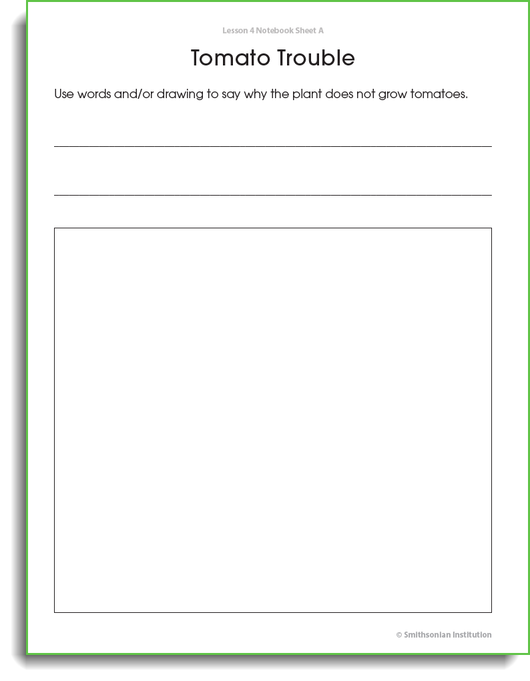
Notes:
After students are introduced to a problem that they need to solve or a phenomenon that they need to explain, it's good to give students an opportunity to share their ideas about what they think is going on. This is an opportunity to find out what students already know about the concepts they are working toward learning in these lessons. We also know that when students connect their new learning to their prior experiences and prior knowledge, they are more likely to remember what they learn.
Notice how much space we give for 2nd grade students. Little fingers need a lot of space to write and draw.
Have participants talk at the their table for just 1 minutes and then share out.
Model talk move here - "Why do you think that?" "What experiences have you had that make you think that?" "What does this problem make you think about?"
Model neutrality with response to answers.

Slide 7
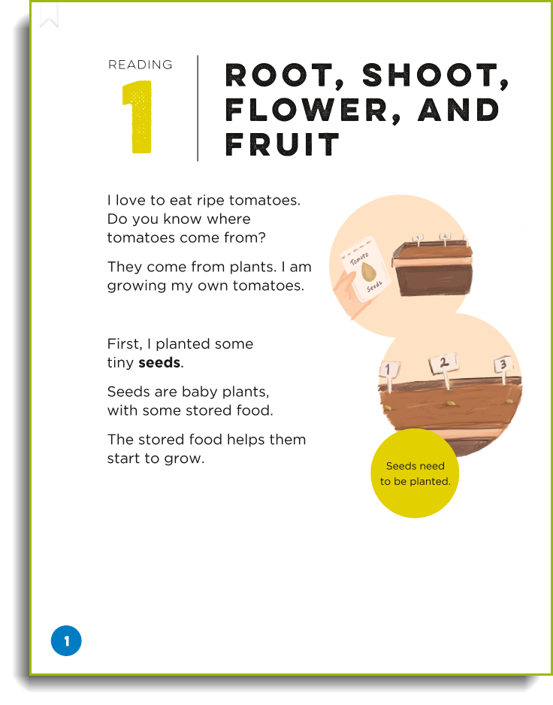
Reading, writing, and speaking for purpose
Notes:
Now students are going to have an opportunity to read about tomato plants to gather more information about this problem and begin to figure out what is going on. Students read a story called, "Root, shoot, flower, and fruit"
In this particular let of lessons, you could use ELA time to teach this whole first section – where students are learning about the initial problem, writing their initial ideas, and then reading to learn more about it.
Use your table of contents and find, Root, Shoot, Flower, and Fruit

Slide 8
Tips for using text to help explain a phenomenon or solve a problem
Introduce the text as informational text
Flip through the story to look at titles, illustrations, and captions – make predictions about what the reading will be about and maybe how it could help explain the phenomenon or solve the problem
Read twice! Many options:
Teacher reads aloud
Students skim to look for important sections
Close read
Pair read
Copy the reading so students can annotate it or have students use sticky notes to label important parts.
Notes:
How can you use this informational text to support students science skills AND their literacy skills?
After bullet 2:
This is a common core reading standard to know and use various text features such as headings, bold print, captions, and glossaries in order to locate information in a text efficiently. So this is exactly what students are doing here...they are looking at those text features to see how they story might be able to give them more information about the problem.
Another Common Core reading standard is that students explain how images contribute to and clarify text. This is something that you can highlight as students share their predictions about how the text will be able to help them solve the problem.
For bullet 3, ask teachers share other options for how they do reading in their classroom.
CCSS.ELA-LITERACY.RI.2.5 Know and use various text features (e.g., captions, bold print, subheadings, glossaries, indexes, electronic menus, icons) to locate key facts or information in a text efficiently.
CCSS.ELA-LITERACY.RI.2.7 Explain how specific images (e.g., a diagram showing how a machine works) contribute to and clarify a text.

Slide 10
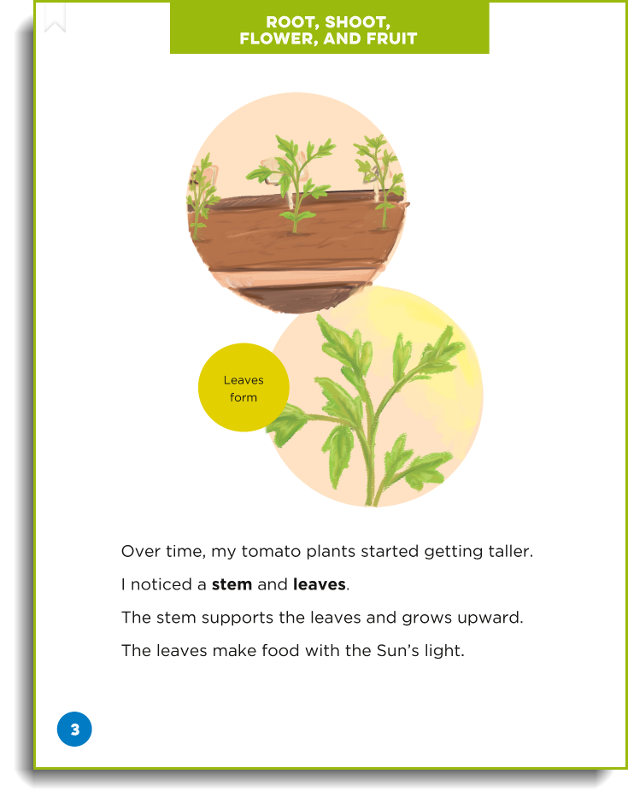

Slide 11
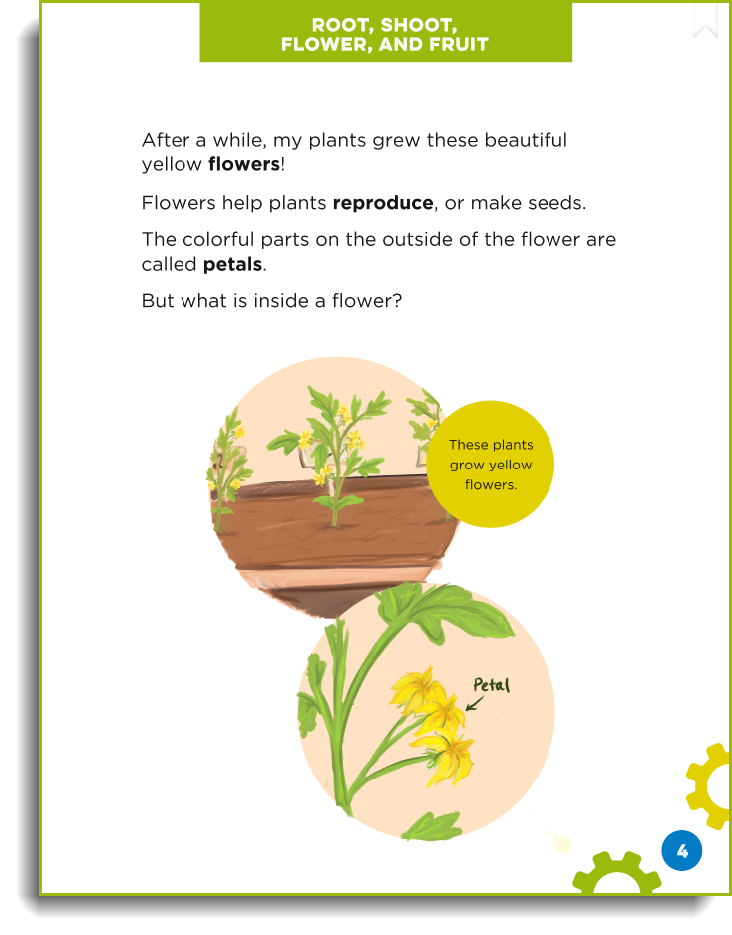

Slide 12
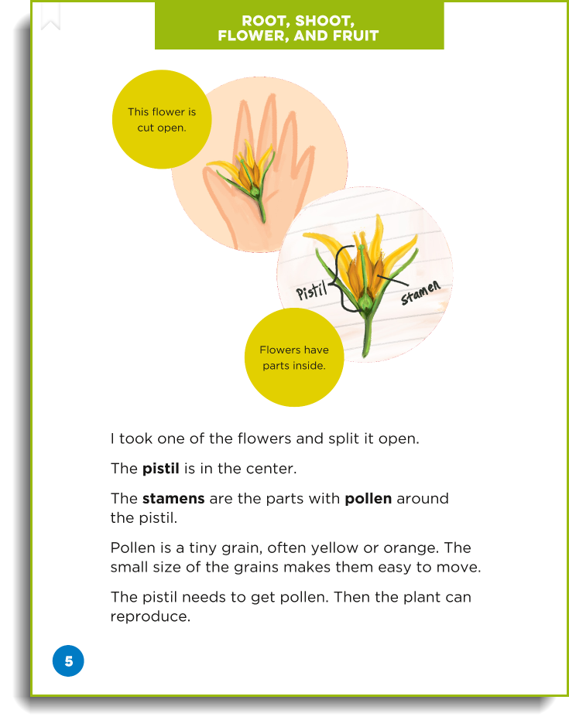

Slide 13
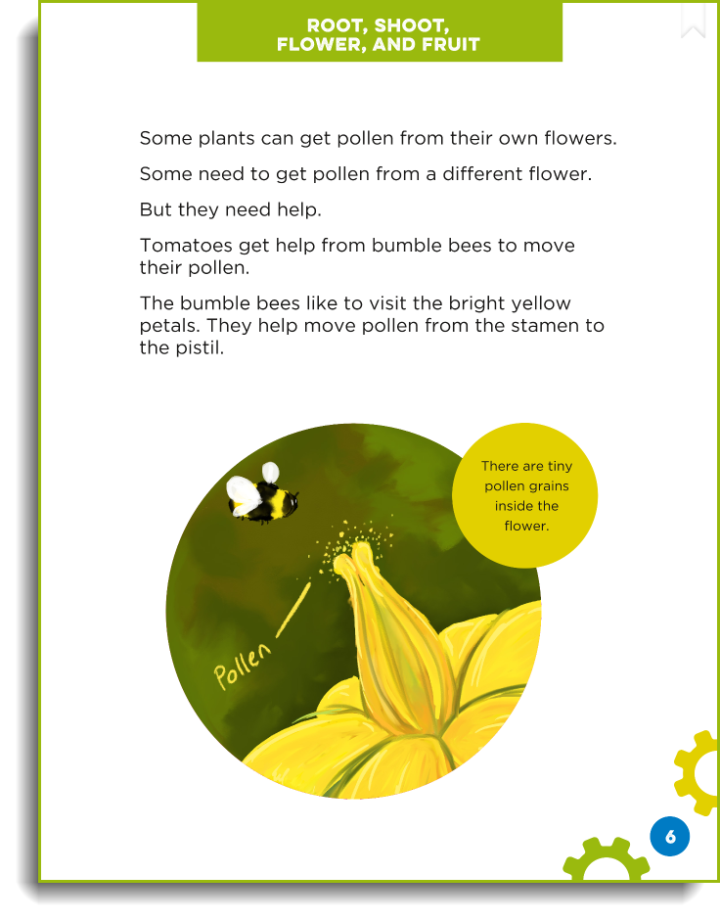

Slide 14
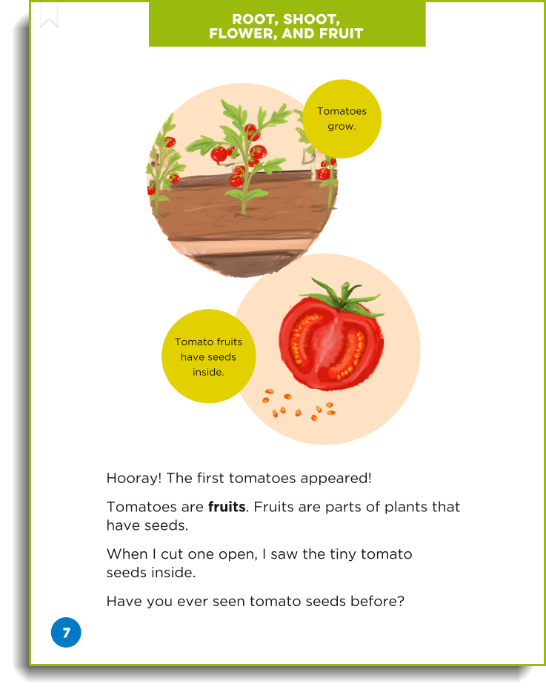

Slide 15
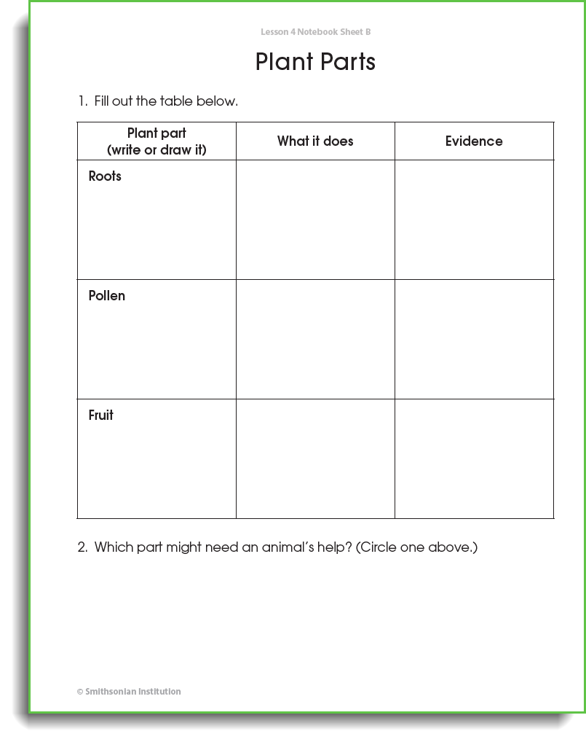
Notes:
We are going to pretend that everyone has already read it once or the teacher has read it aloud and for the second read, students are going to look for particular information about particular part of the tomato plant.

Slide 16
Tomato Plant Parts
Notes:
Students are also given images of real tomato plants to compare to the illustrations in the reading as they are writing what different plants parts look like and what they do.

Slide 17
Why Don't the Plants Grow Tomatoes?
Claim | Evidence
Notes:
After reading, writing, and talking about the different parts of the tomato plants and what they do, students go back to the problem they encountered at the beginning of the lesson: Why Don't the Plants Grow Tomatoes?
Students are answer this question with a claim and using evidence from the lesson to support their claim. This might be hard for students. The answer to this question was not in the reading. The answer to this question wasn't said before. So they need to use what they learned to better understand that problem that they encountered at the beginning of the lesson.
Talk moves
What did you read that supports that?
Use annotation in reading as evidence

Slide 18
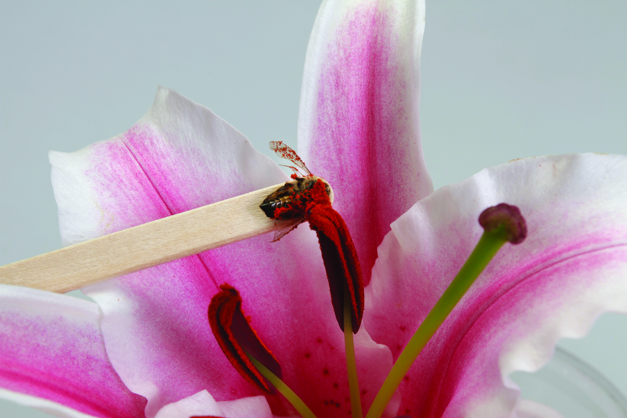
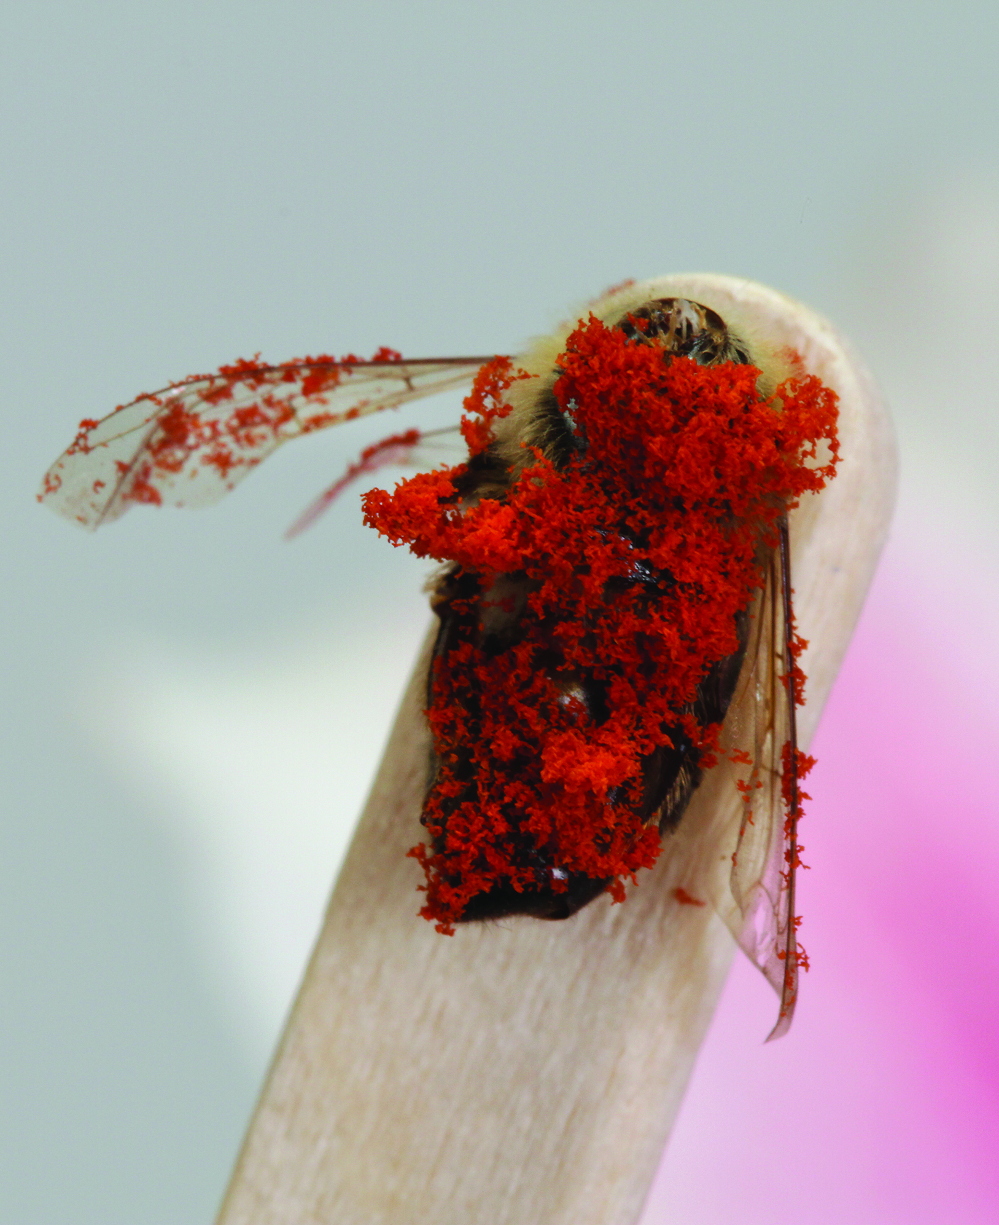
Students investigate bees and flowers
Notes:
In the next lesson, students observe bees, observe flowers, and investigate what structures of bee bodies function to pickup and move pollen between flowers.

Slide 19
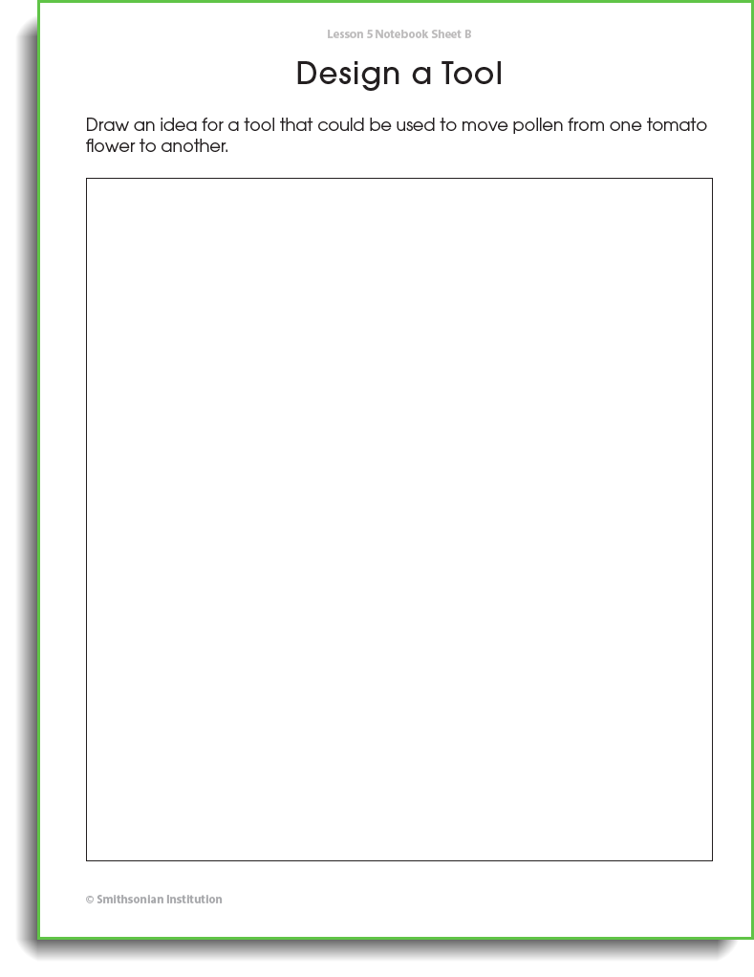

Slide 20
Task: Design a Hand Pollinator
Activity

Slide 22
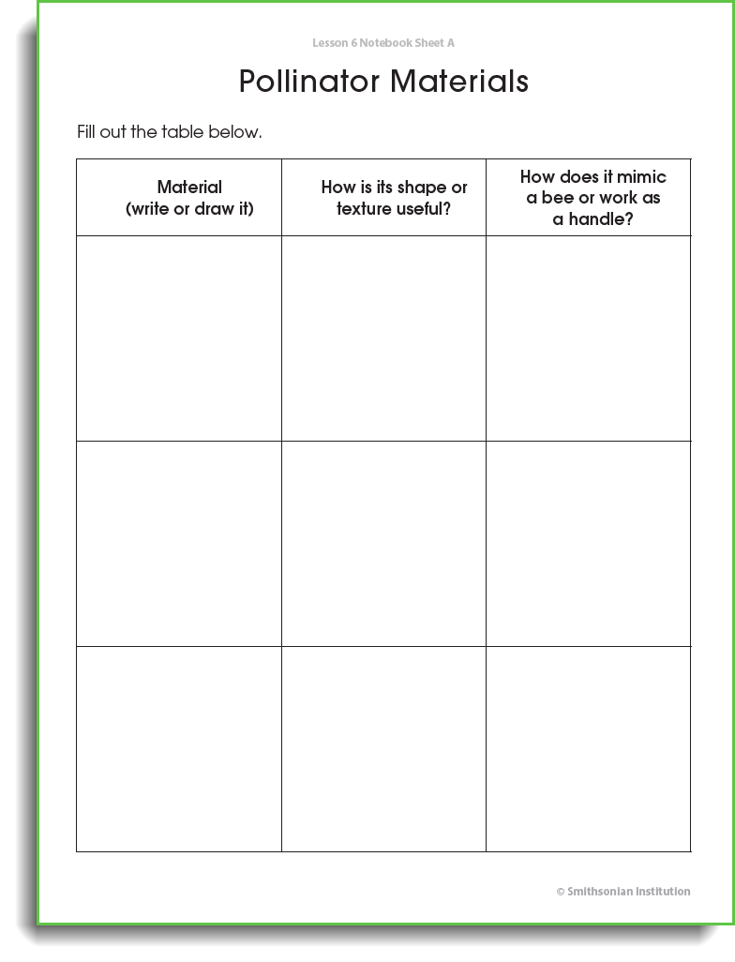
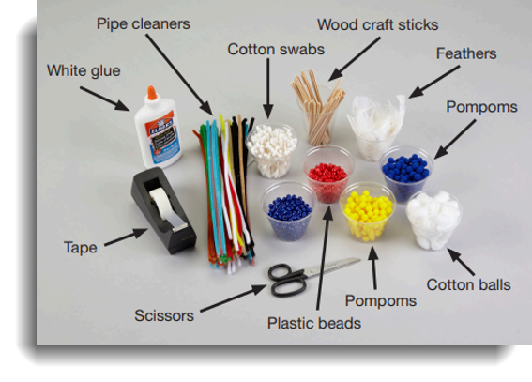

Slide 23
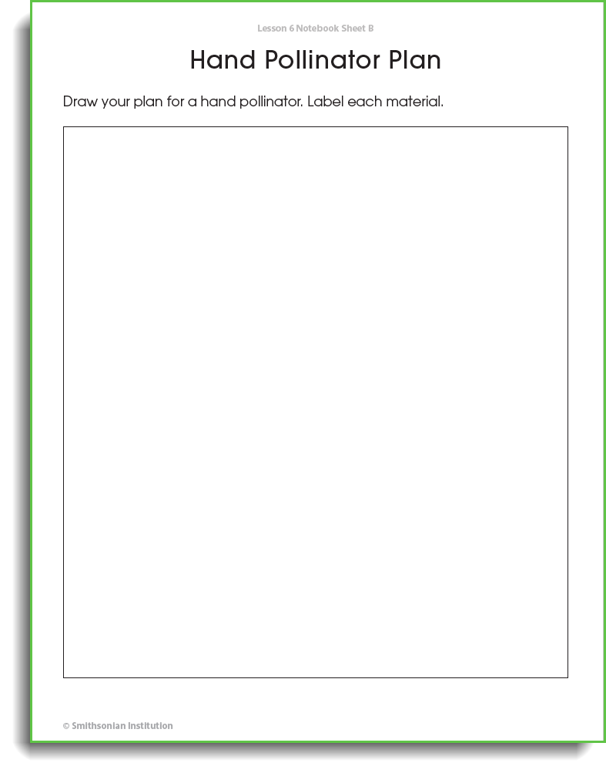

Slide 24
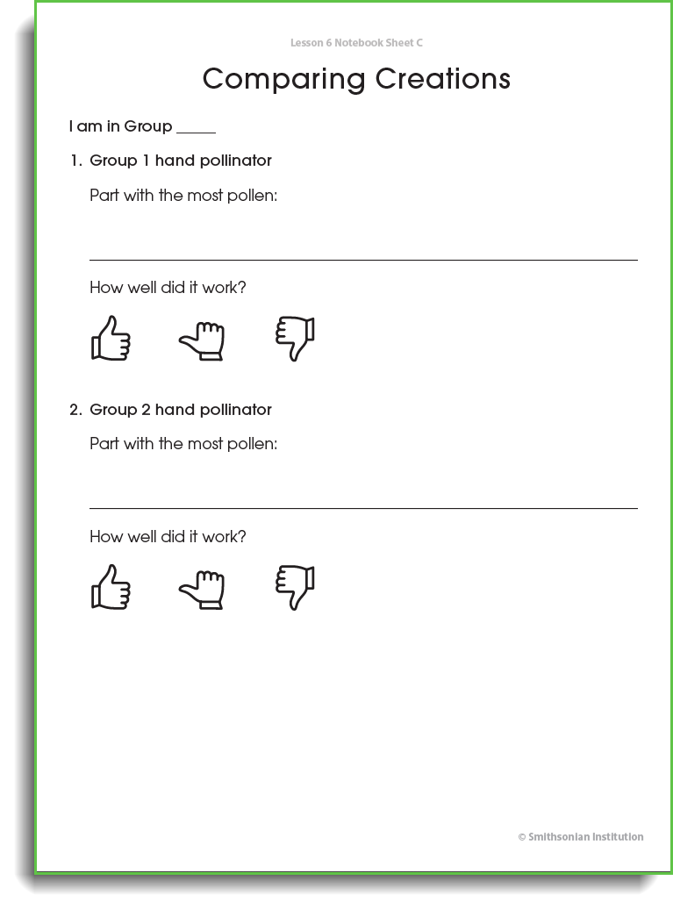

Slide 25
Connection between 2nd grade and 3rd grade modules
Grade 2 DCI: Plants depend on animals for pollination or to move their seeds around. (LS2.A)
Grade 3 DCI: Reproduction is essential to the continued existence of every kind of organism. Plants and animals have unique and diverse life cycles. (LS1.B)
Notes:
(Sarah) Next we're going to take a look at the 3rd grade module. And the core idea that students are going to learn about in the 3rd grade module builds nicely on the core idea they just learned about with the bees pollinating tomato plants. So we just covered (read G2 DCI) and now students are going to take a step back to really think about animal life cycles and the roll of reproduction to the continued existence of life.
DCI stands for disciplinary core idea.

Slide 26
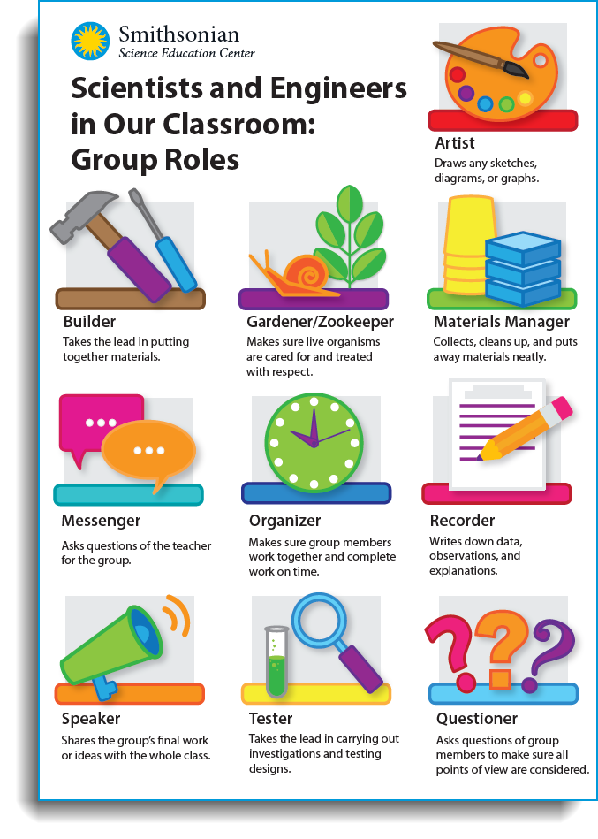
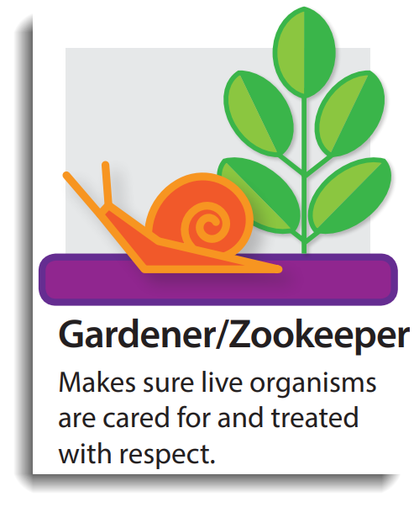
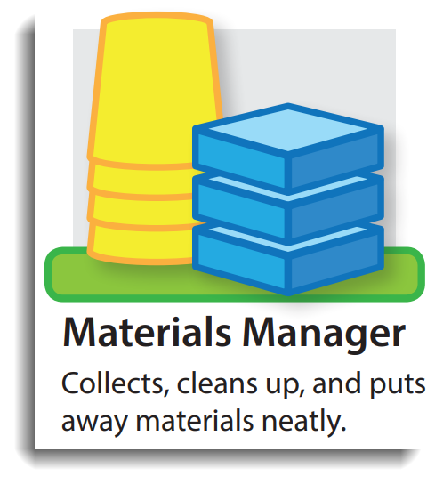
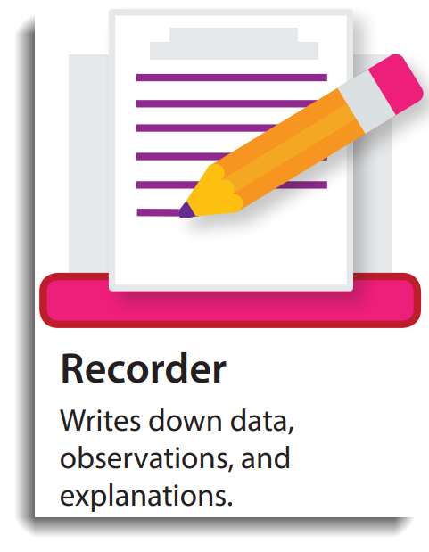
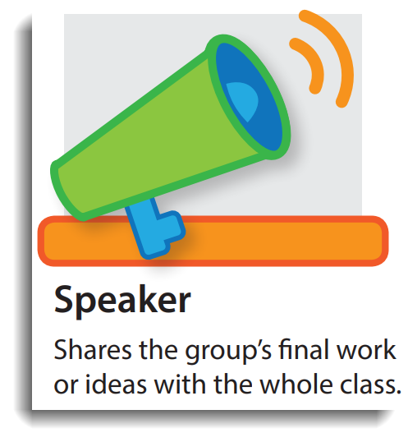
Group Roles
Notes:
Group roles poster. Each student takes on a role. The success of the entire group depends on each group member fulfilling their role.

Slide 27
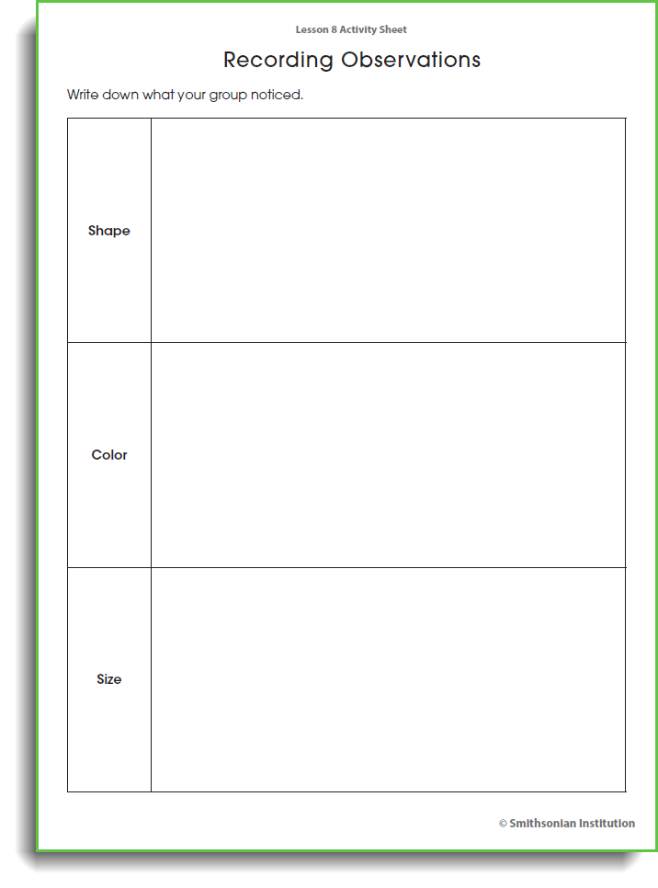
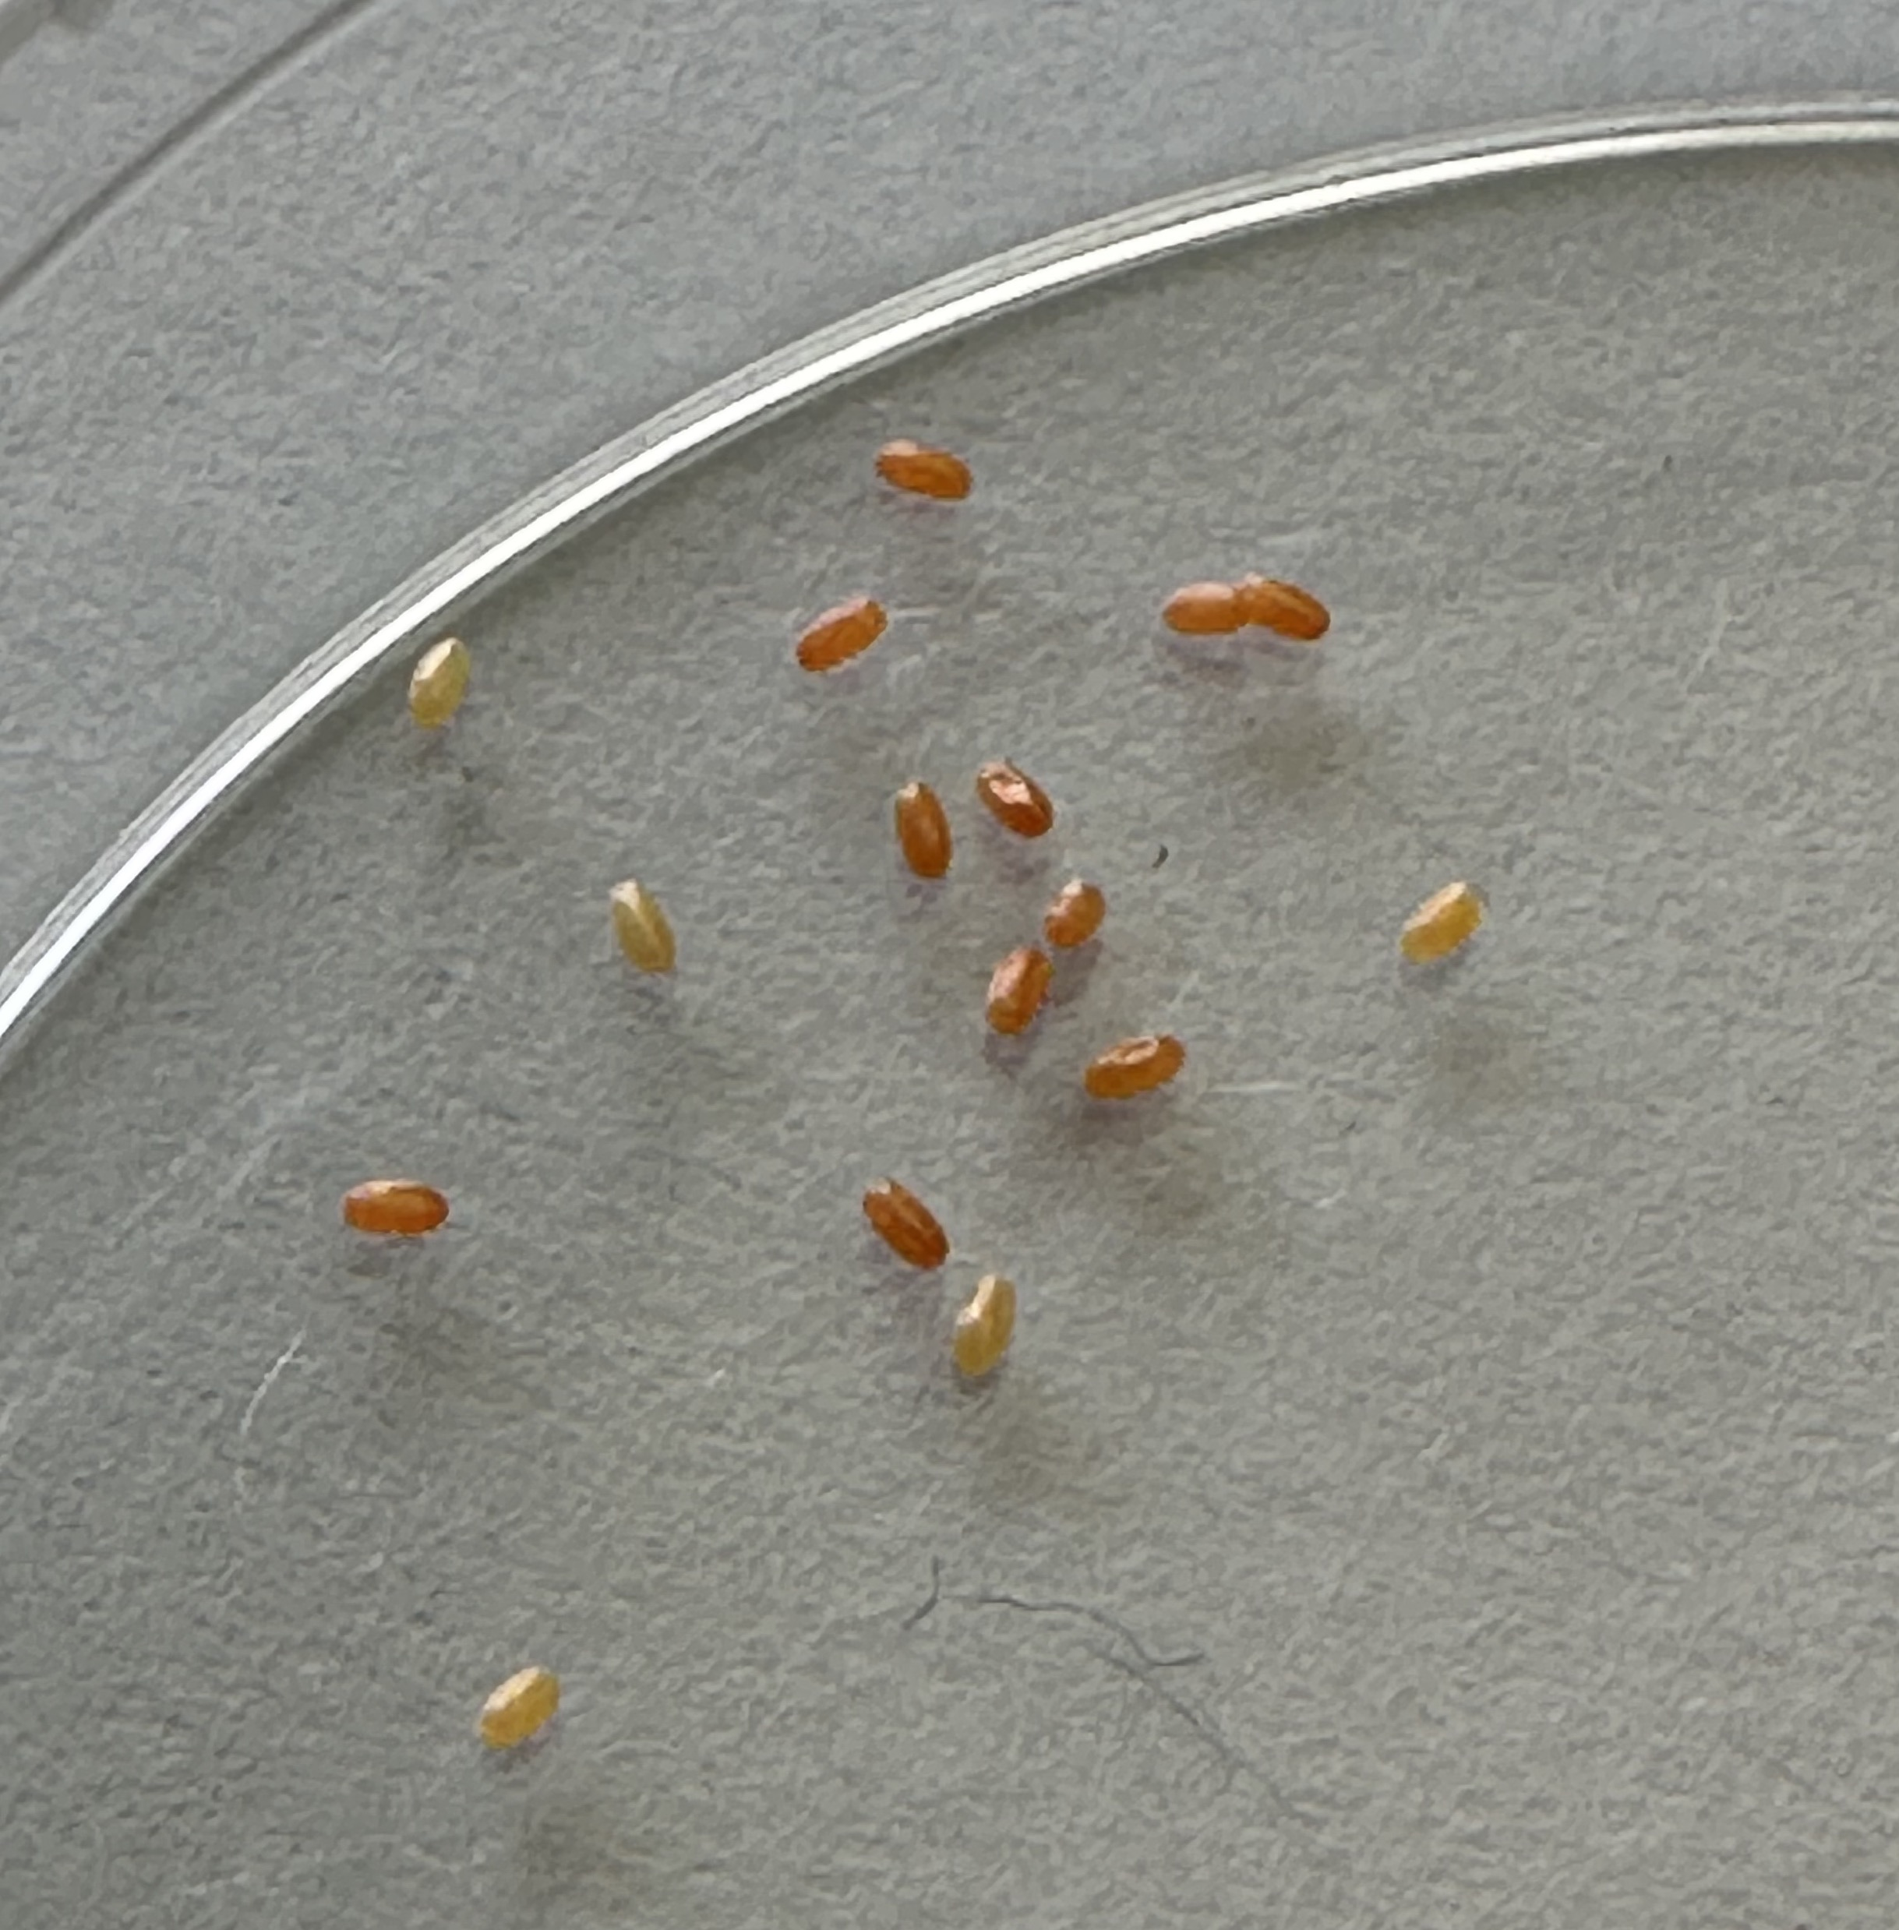
New phenomenon:
Notes:
To kick this off, students are going to have a chance to observe this...
Hoover, please add L8 Activity Sheet to this slide
ScienceEducation.si.edu/variation-phenomenon

Slide 28
What will happen next?
Notes:
Hoover, please add Lesson 8 Notebook Sheet B
Then students observe the milkweed bug nymphs.

Slide 29
Ages and Stages

Slide 30
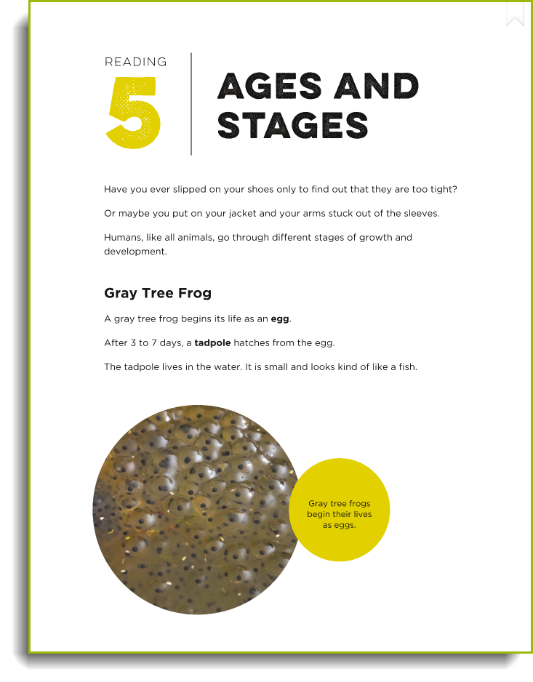
Ages and Stages

Slide 31
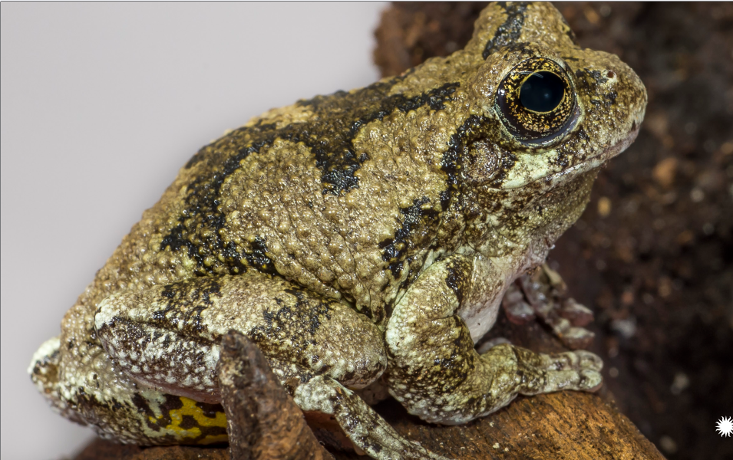
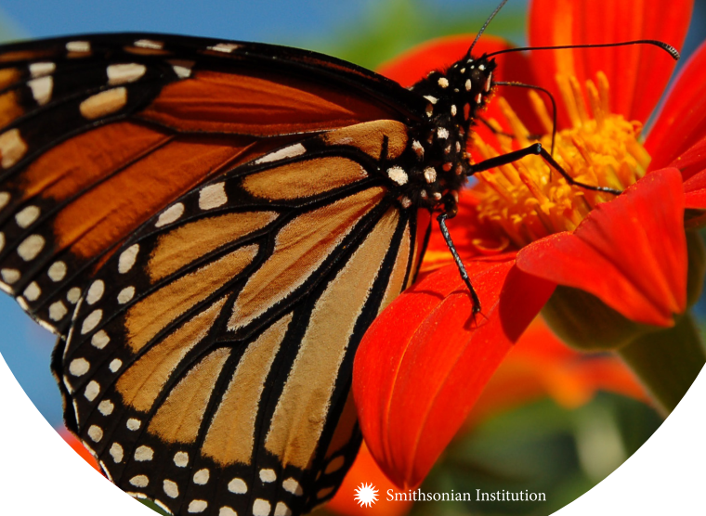
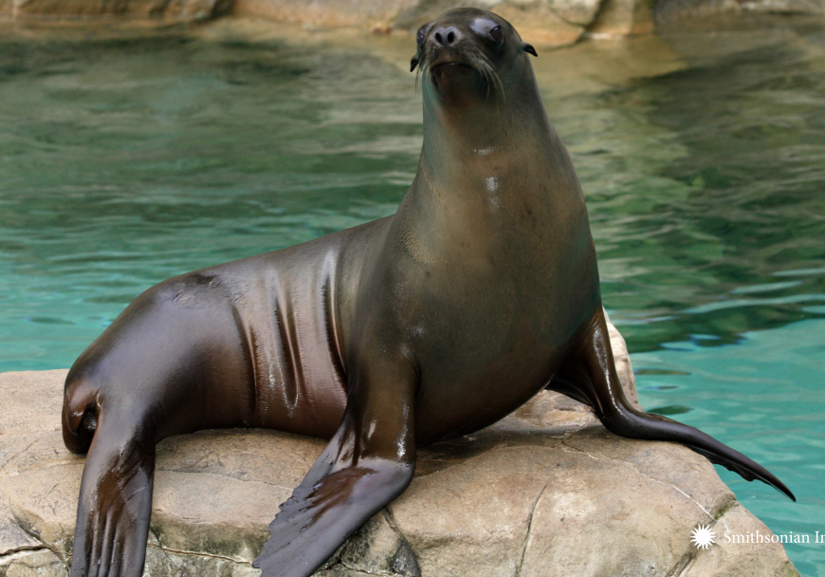
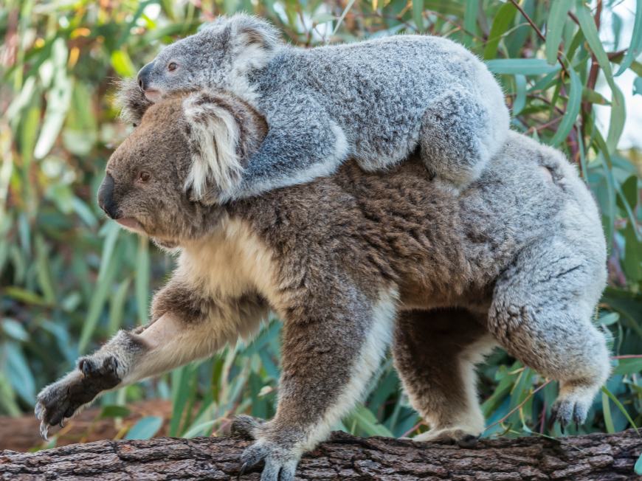
Choose an animal to read about:
Notes:
With a partner, read about one of the four animals in the ages and stages reading: gray tree frog, monarch butterfly, california sea lion, and koala
Complete the Lesson 9 Notebook Sheet B
Meet with another pair, present about your animal and decide on a common pattern that fits both animals.
Make a revised prediction about the milkweed bugs!

Slide 32
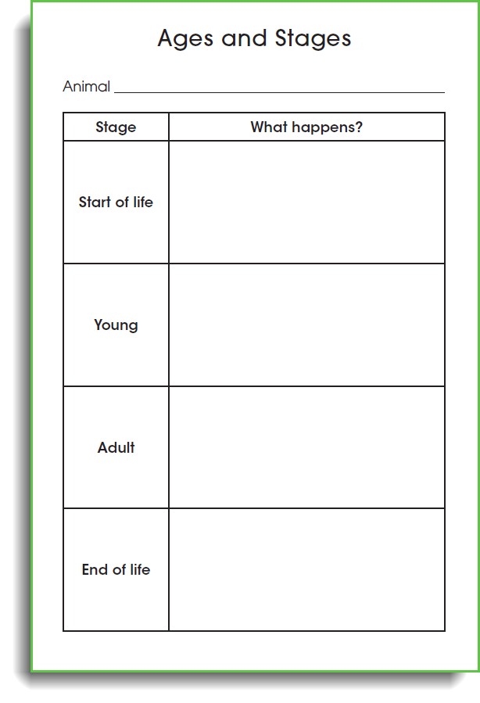
Choose an animal to read about:
Notes:
With a partner, read about one of the four animals in the ages and stages reading: gray tree frog, monarch butterfly, california sea lion, and koala
Complete the Lesson 9 Notebook Sheet B
Meet with another pair, present about your animal and decide on a common pattern that fits both animals.
Make a revised prediction about the milkweed bugs!

Slide 33
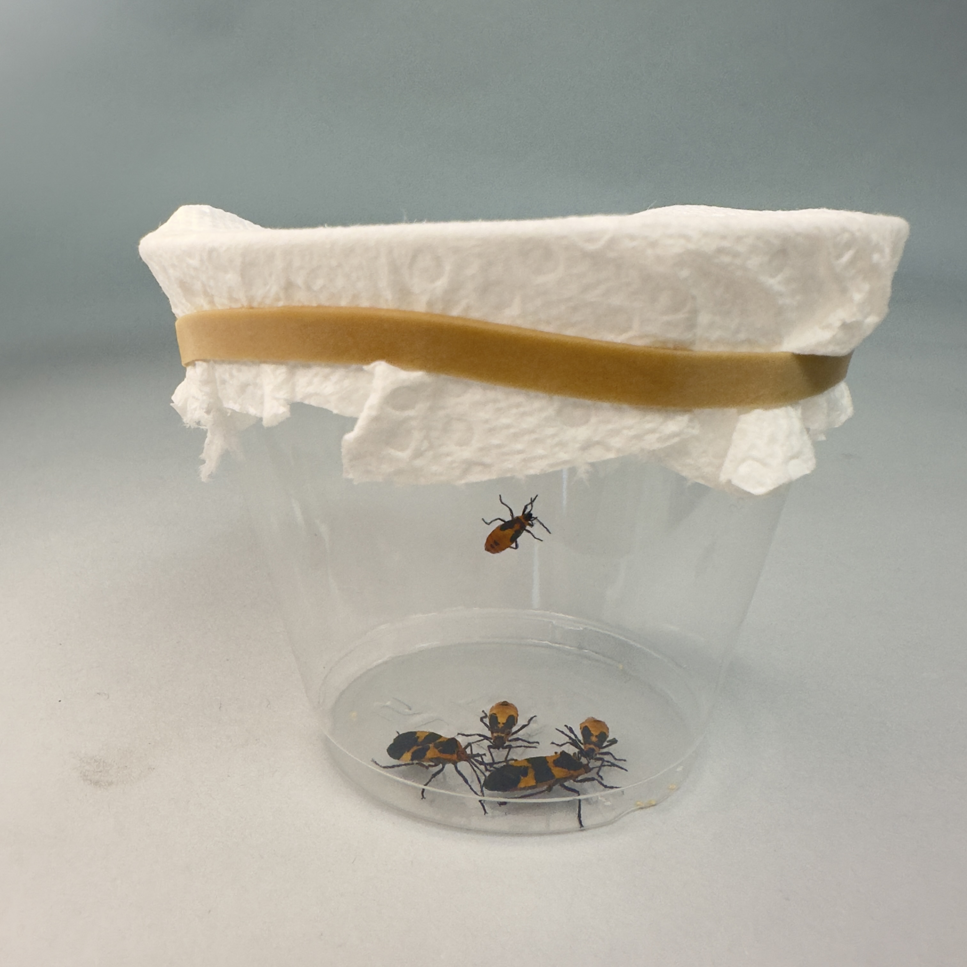
More observations!
Notes:
Students make their last predict of the milkweed bugs and then draw their final model of the milkweed bug life cycle

Slide 34
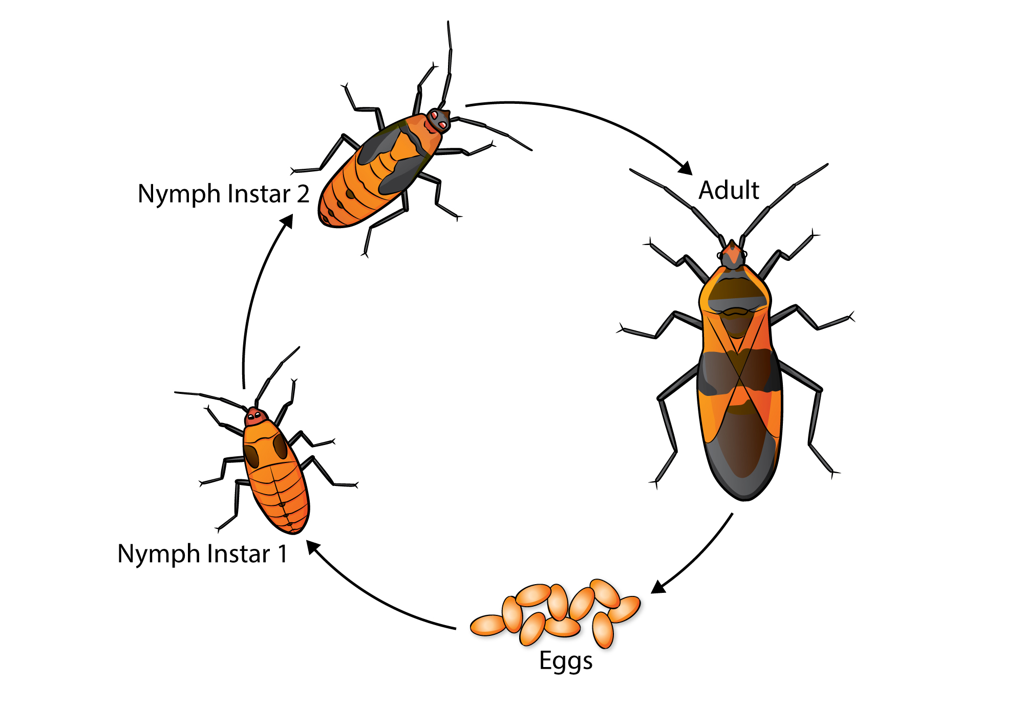
Milkweed Bug Life Cycle
Notes:
(Sarah) After students observe the milkweed bugs 3 times, they make a final prediction about what the milkweed bug life cycle looks like. This image is teacher-facing only. There is not one right answer for the milkweed bug life cycle. As long as they show the eggs, as long as they show at least two different bug stages, they did good. If they see this, they will think this is the only right answer.

Slide 35
When did students build their literacy skills?
When did they build their reading skills?
When did they build their writing skills?
When did they build their speaking and listening skills?
Notes:
(sarah) Read slide questions
Reminder that the reading and writing sections of both these lessons could take place during ELA time of the day.
And I know I mentioned this at the beginning, but when students are building their reading skills, writing skills, and speaking skills in this way, we know it can make a difference because students using this program....(share randomized controlled study results)

